Slide 1
CS 416 Web Programming Java Server Faces cont.
Dr. Williams
Central Connecticut State University

Slide 2
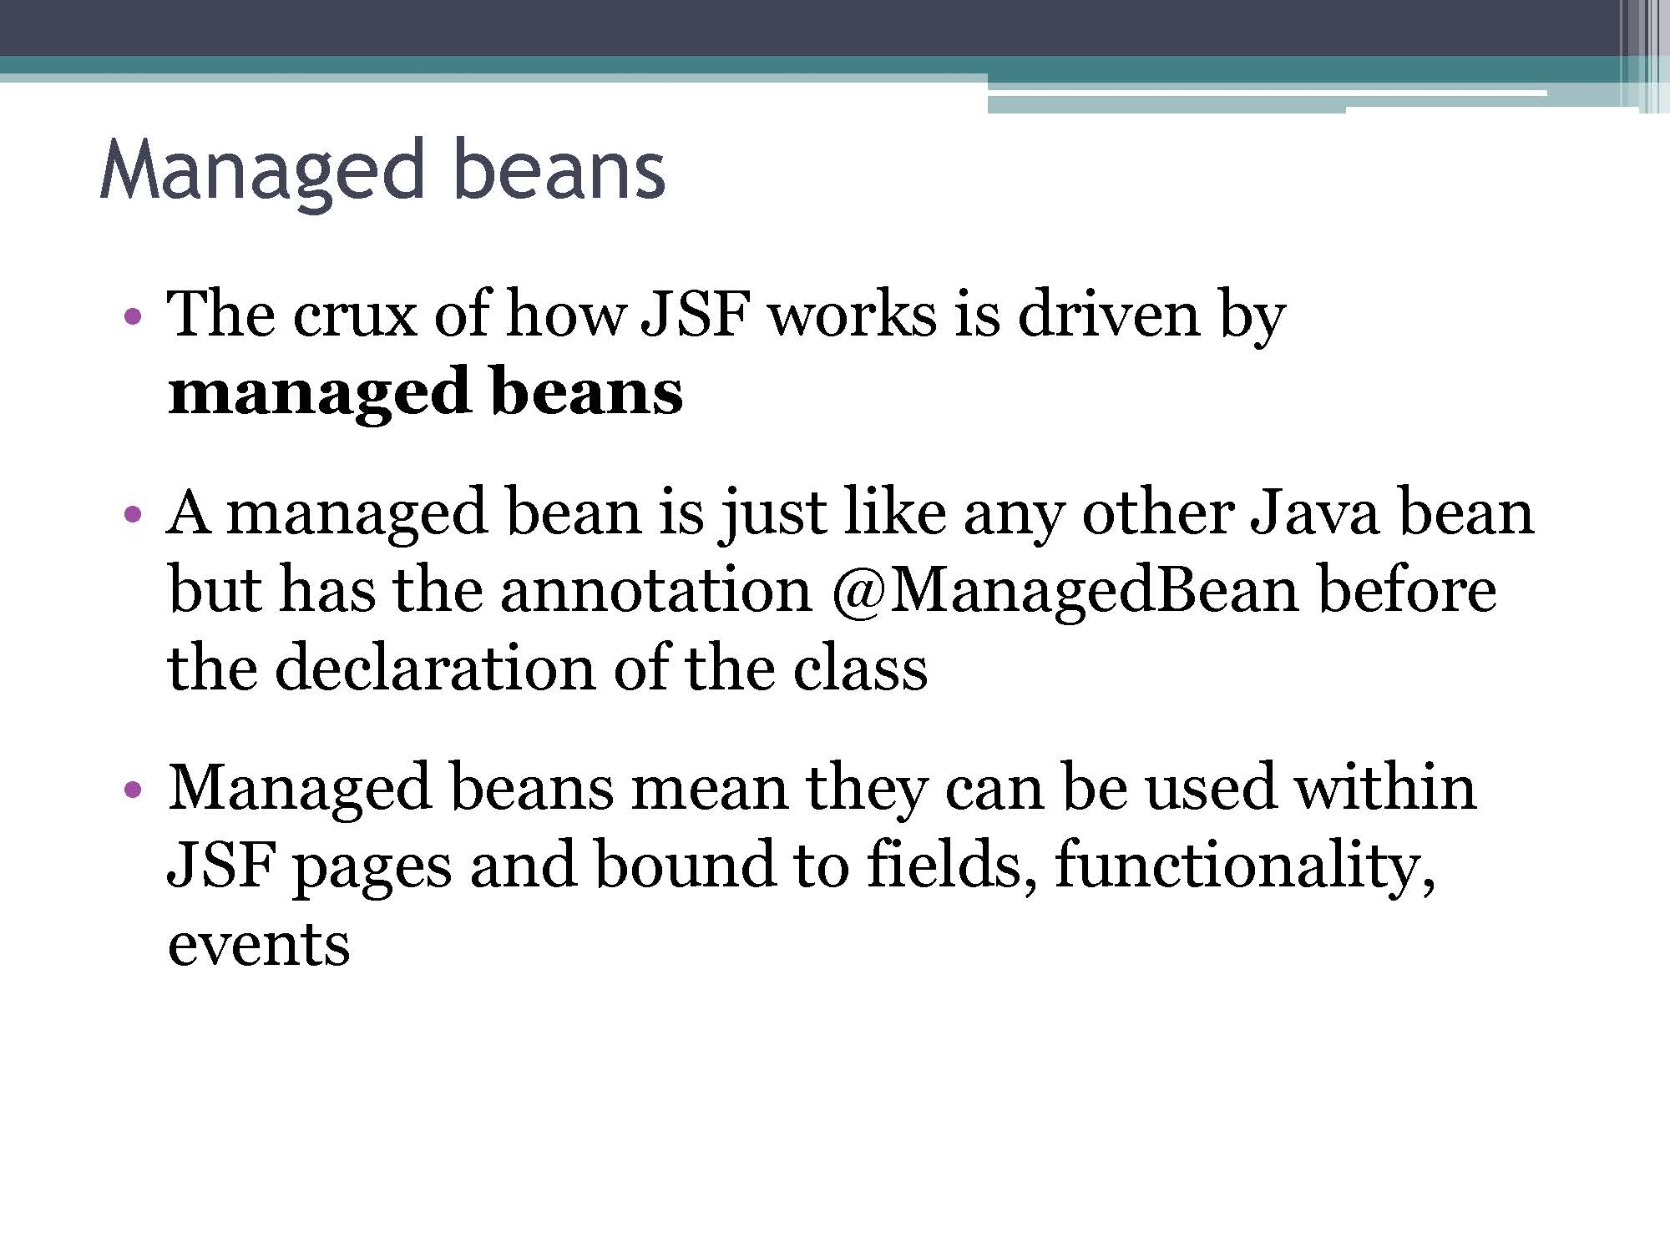

Slide 3
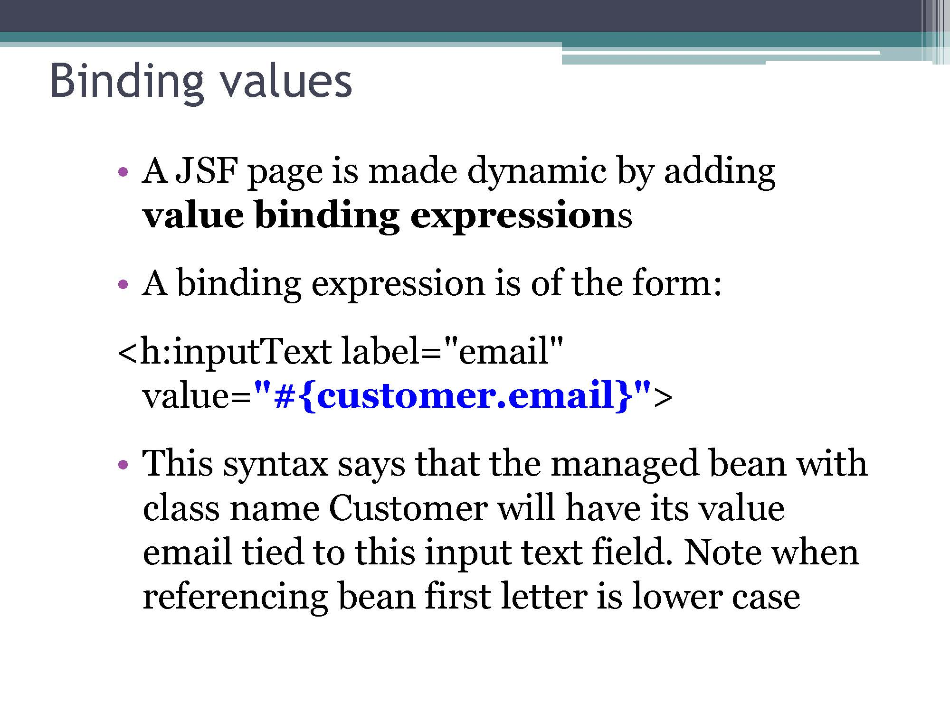
confirmation.xhtml

Slide 4
Binding example
carDataEntry.xhtml
carSaved.xhtml
Key things bind of input and output the same
Bound objects page to page no need to specify population of values – bindings specified in original page already populated on target page

Slide 5
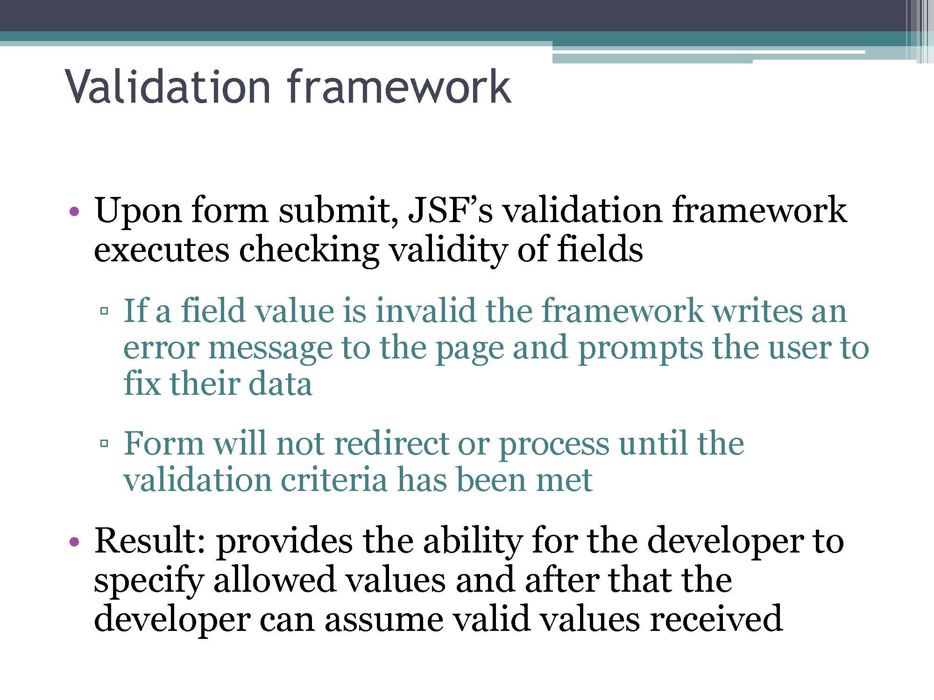

Slide 6
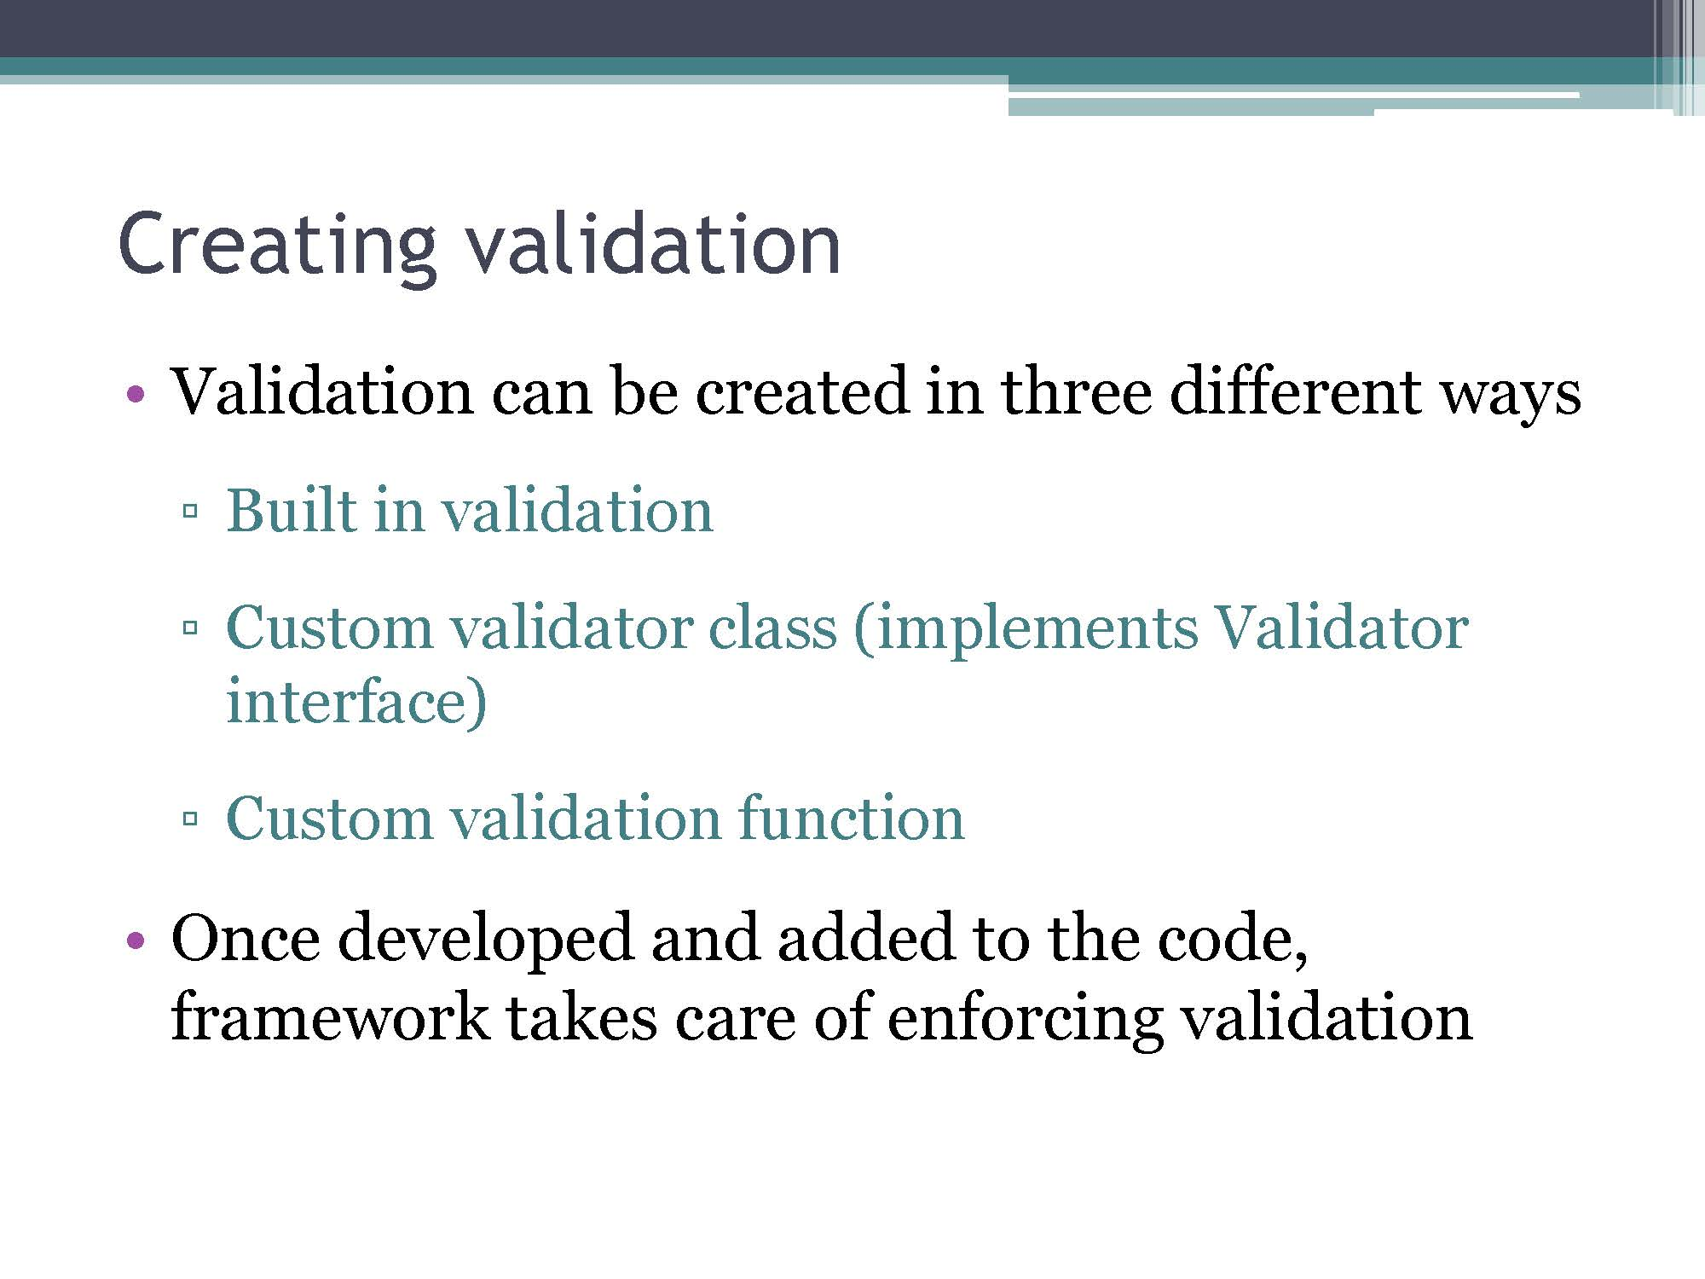

Slide 7
Validator review: Standard validation
Validation tag | Description
<f:validateLength minimum=“2” maximum=“5”> | Verifies input length is between the tag’s minimum and maximum values
<f:validateDoubleRange minimum=“0.2” maximum=“75.5”> | Verifies input is valid Double within the specified range inclusive
<f:validateLongRange minimum=“-56” maximum=“1234”> | Verifies input is valid Long within the specified range inclusive
<f:validateRequired> | Validates that the tag is not empty (same as adding required="true" in the input text tag)
<f:validateRegex pattern=“[a-z]+”> | Validates that the value is in the format specified by the regular expression in the pattern attribute
<f:validateBean> | Allows validation to be done by annotations on the managed bean without having to add validators to the JSF tags

Slide 8
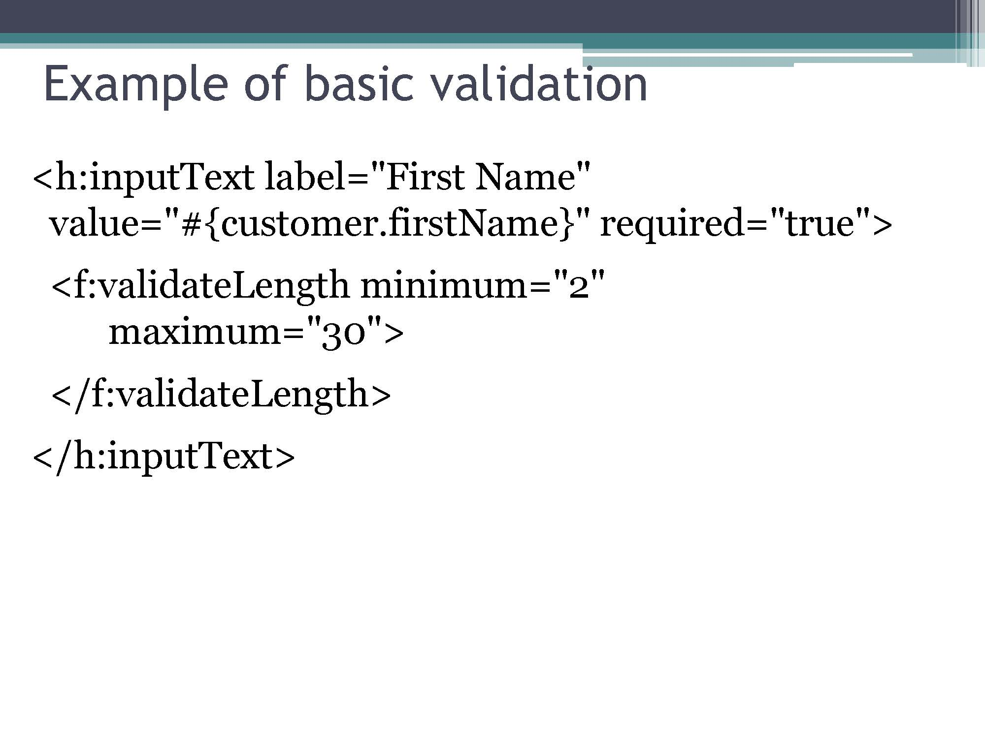

Slide 9
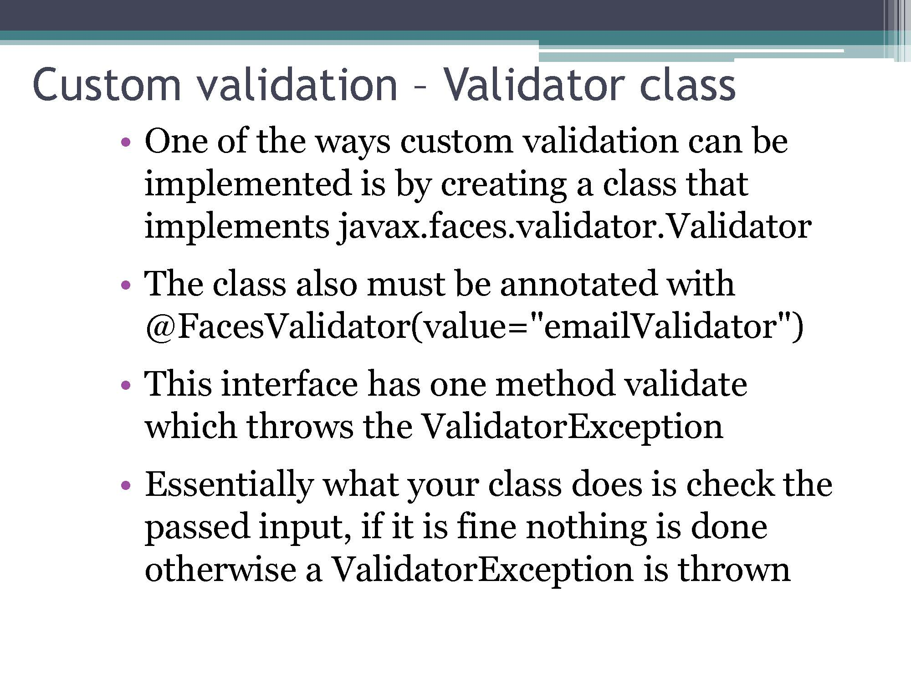
EmailValidator.java

Slide 10
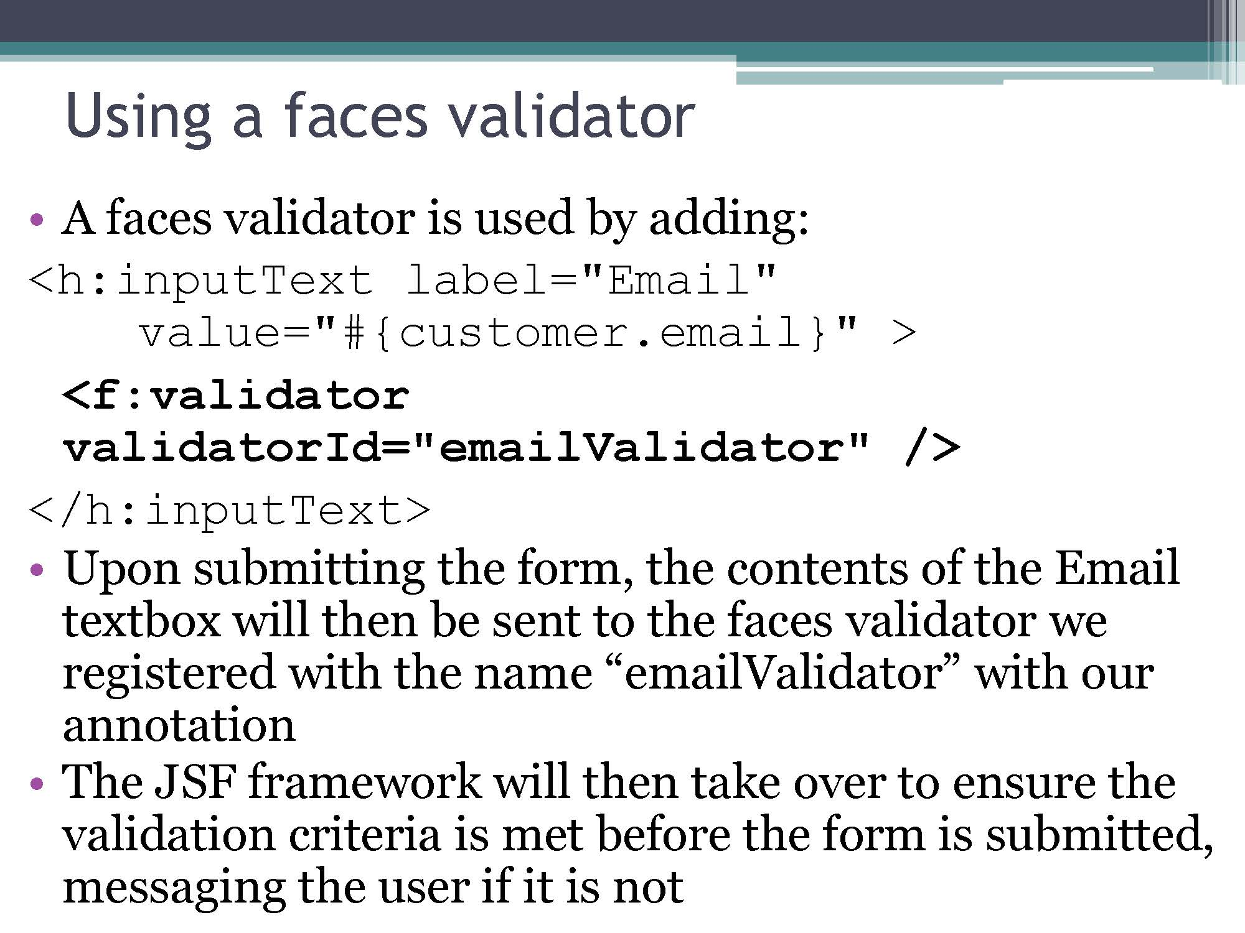

Slide 11
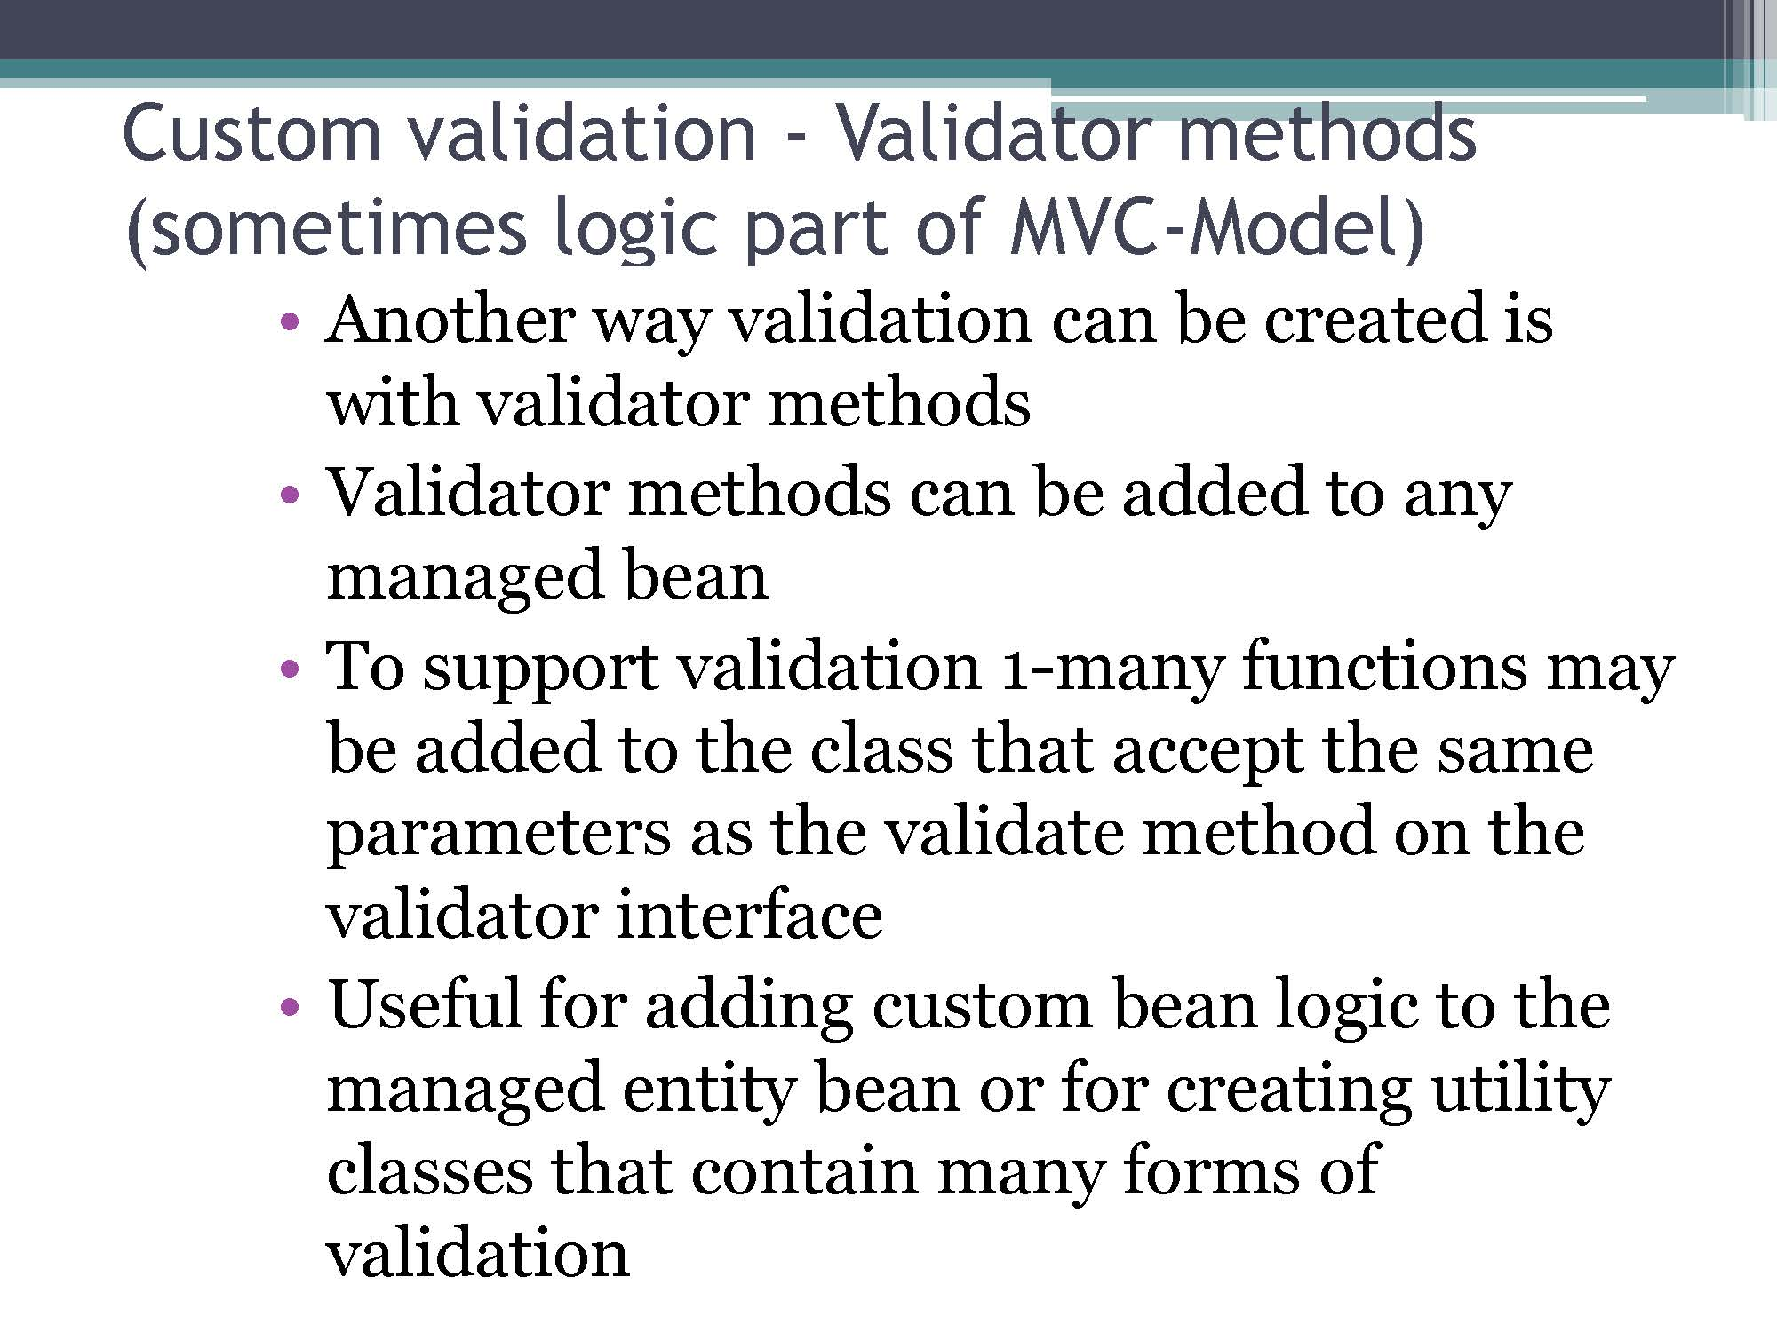
ValidationUtils.java

Slide 12
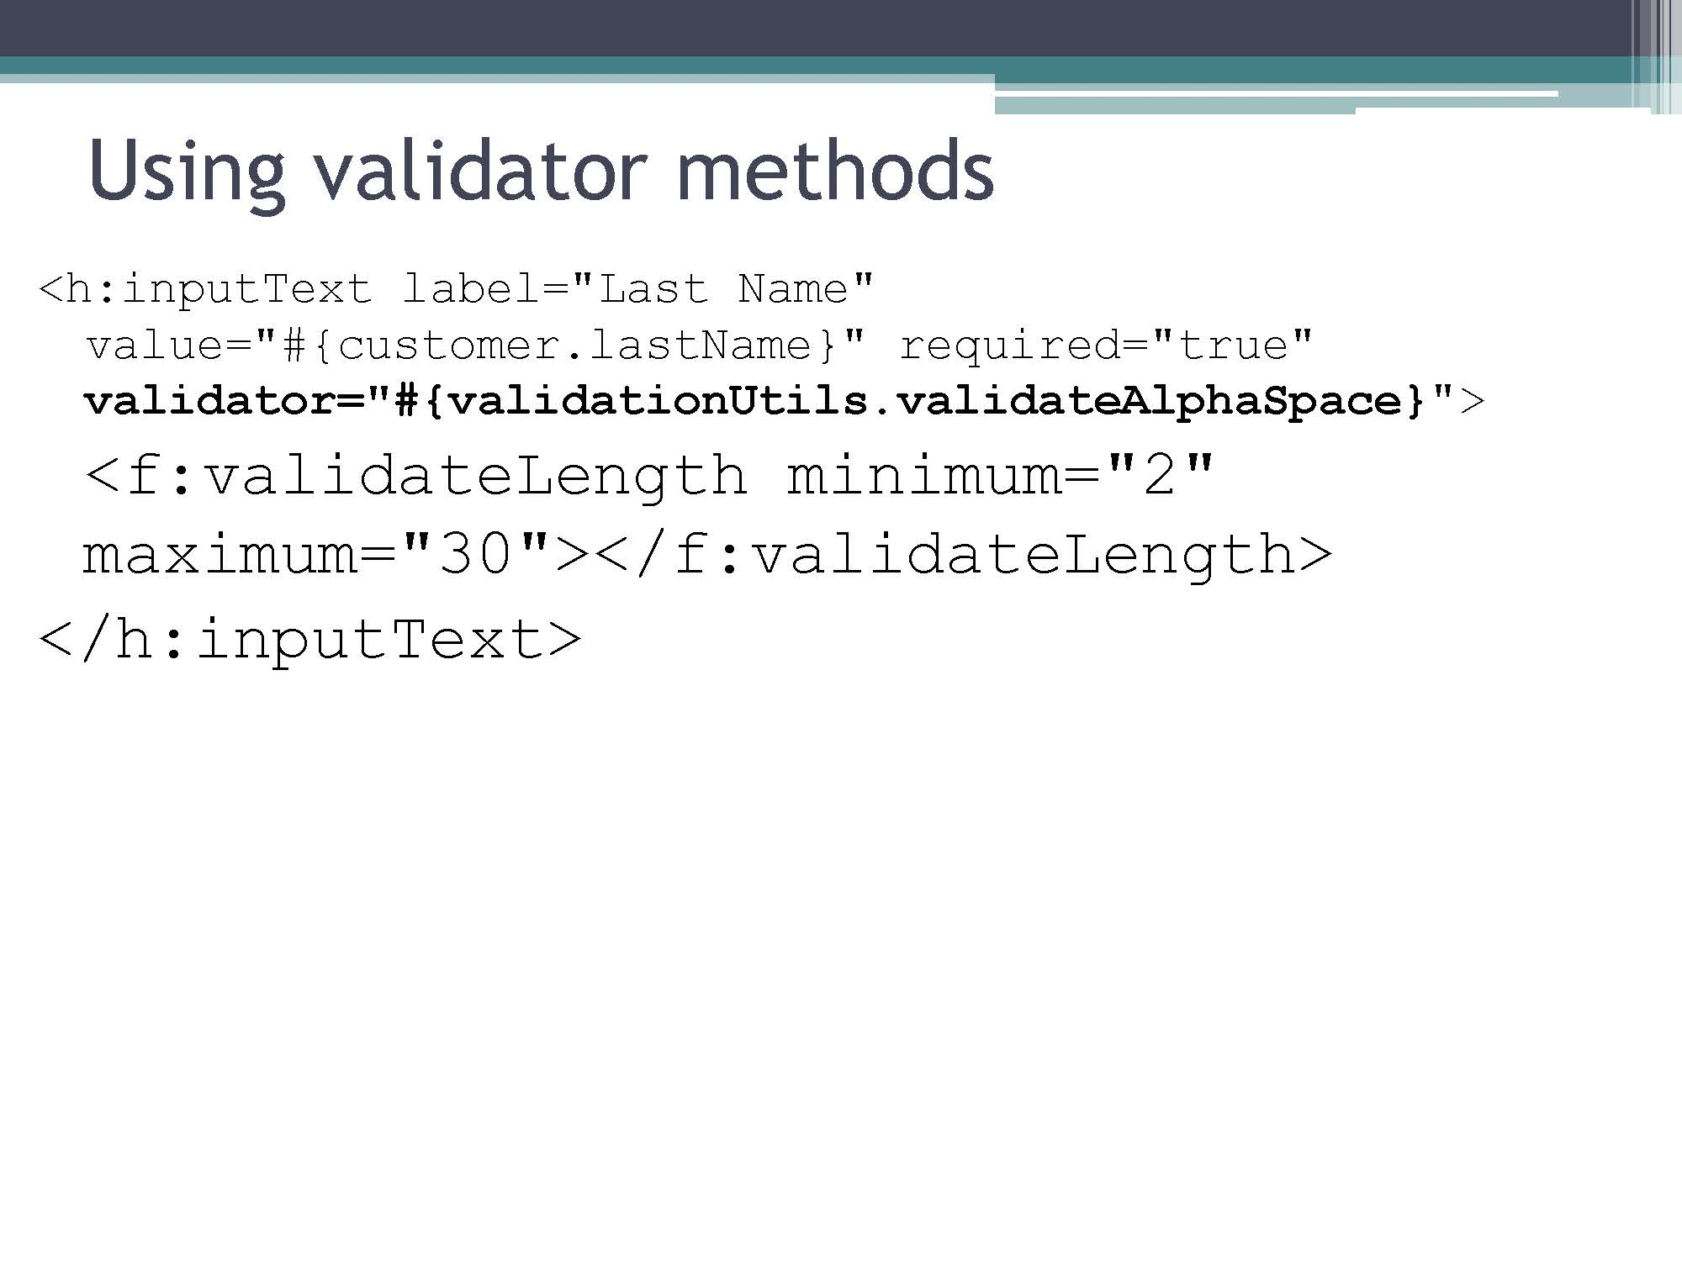
Example of all: CarDataEntrySoln.java

Slide 13
MVC – Model Integration with JPA
One of the main benefits of JSF is its seamless integration with the data model and the controller logic
Since there is nothing special about Managed beans other than the @ManagedBean annotation a managed bean can also be an entity bean
Binding values on page enables easy persistence and reading from DB

Slide 14
MVC - Controller
The last component of MVC is the controller which is responsible for the flow of the application and persistence
The JSF framework does this by being able to direct control to managed beans
Managed bean provides method that command button (<h:command>) can bind to its action

Slide 15
Controller cont.
Controller is responsible for
Enhancing object model values if needed
Persisting data if needed
Directing the application to the next page

Slide 16
Controller setup
Like the other components in the JSF framework, the controller is also a managed bean
Functions that can be bound to the pages action need to take no parameters and return a String
String returned will be the page the application should be directed to

Slide 17
Controller and data model
For the controller to access a bean an attribute for that bean must be added as a property of the controller bean
Property is then marked as
@ManagedProperty(value = "#{customer}")
private Customer customer;
Which binds the customer bean to the customer attribute
The controller can then persist the bean by creating an instance of the entityManager and calling persist on the bean

Slide 18
MVC demo
customerDataEntry.xhtml
CustomerController.java
confirmationSaved.xhtml

Slide 19
Creating your own MVC
Modify controller CarController to control submission of the car info page that persists the car before directing the browser to the display page CarSaved

Slide 20
JSF and Ajax
Ajax can be added to JSF facelets with very little code
All of the client side JavaScript needed is generated
Asynchronous call
Waiting for readystate
Parsing and injecting results in the page
Result is developer can focus on content rather than details

Slide 21
Ajax tag
Within a JSF page the Ajax tag of the JSF standard components:
<f:ajax
The tag is used as a child of another tag
Respond to event related to tag
Respond to action of parent element

Slide 22
Tag structure
<h:inputText id="txtInput" value="#{controller.text}">
<f:ajax render="myTargetId" event="keyup" />
</h:inputText>
Basic flow is when the keyup event is fired the value of the parent tag (txtInput) will be set to the bound variable (controller.text)
The render attribute specifies one or more target id’s that should be updated (if more than one, separated by spaces)
Render specifies the ids of the tags that should be updated with their new bound values

Slide 23
Events
Ajax can be tied to any parent element’s actions
Blur, change, click, dblclick, focus, keydown, keypress, keyup, mouseup, mousedown, mousemove, mouseout, mouseover, select, valueChange
Alternatively can be tied to action listener (covered later)

Slide 24
Design of update
When bound attribute is updated through the set method application takes action and updates relevant information so get on rendered elements return the results
Generally:
If updates are based on consistency of bean, Ajax is tied to bean element
Otherwise seter is called on a controller which executes some logic then updates relevant fields

Slide 25
Multiple arguments
By default the only value updated is parent of Ajax tag
To specify multiple bound attributes should be updated can be specified with the execute attribute
<f:ajax execute="firstName lastName" render="fullName suggestedLogin"...
Result is parent and both firstName and lastName bound attributes updated and then render update on updated bound attributes

Slide 26
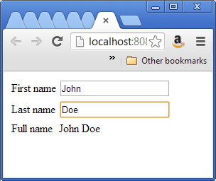
Name example (nameExample.xhtml)
Add ajax to input fields
Respond to keyup
Tag’s field will be updated automatically – need to execute any other related fields
Render full name which will take new bound values

Slide 27
Ajax on actions
Alternative to responding to events is to respond to actions
Action is user clicking on a command button (button) or command link (appears as URL)
Adding Ajax to command is typically done to update the page without actually changing the page Ex.
Calculations
Search

Slide 28
Actions cont.
Rather than acting on setters a command can be bound to a method as an Action Listener
<h:commandButton
actionListener="#{controller.calculateTotal}"
value="Calculate Sum">
<f:ajax execute="first second" render="sum"/>
</h:commandButton>

Slide 29
Action listeners
Action listeners generally a method on a controller designed to perform functionality similar to submit
When combined with Ajax form processing result is page update without reload of submit
To implement action listener, any method that returns void and takes as parameters a javax.faces.event.ActionEvent as its argument
public void calculateTotal(ActionEvent event){
}

Slide 30
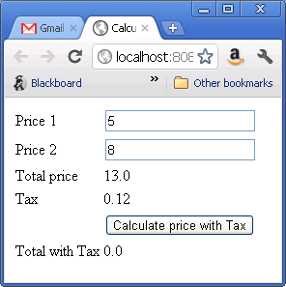
Ajax in action
Create a basic sales calculator
Use Ajax event handler so that when price1 or price2 is updated the total price reflects the change
Use action listener to update total with tax when clicked calls listener method:
priceCalculation.calcTotalWithTax
(this could also be just populated dynamically as above but this gives you an example of an action listener)

Slide 31
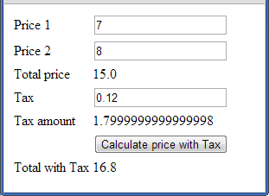
Your turn
Modify ajaxInActionWithTax
Update code so changing price1, price2 or tax displays the new tax amount

Slide 32
Working with record sets
To create a table of a list of items use
<h:dataTable
Element and bind contents to controller method to retrieve matching records
See customerSearch.xhtml and CustomerController.getMatchingCustomers

Slide 33
Ajax in action
Create a car search page
User can enter part of car make and get results
Add lookup method to controller
Create jsf to call and display results
How would you modify it so you could enter part of make AND part of model?

Slide 34
Project stages
One of the features of JSF is for the application and application server to behave differently whether in development or production
SystemTest
UnitTest
Development
Production
Specifically the application server will log differently depending on production stage – ie. More debugging information in development, no informational logging in production

Slide 35
Project stages cont.
In addition to having the application server automatically adjust its logging, your code can execute based on the property as well:
FacesContext facesContext =
FacesContext.getCurrentInstance();
Application application =
facesContext.getApplication();
if (application.getProjectStage().equals(
ProjectStage.Production){
//do something
}else if (application.getProjectStage().equals(
ProjectStage.Development){
…

Slide 36
Setting the project stage
To set the project stage a custom JNDI resource must be defined
In the GlassFish admin console
Go to JNDI|Custom resources
Click new
Enter:
JNDI Name: java.faces.PROJECT_STAGE
Resource type: java.lang.String
Factory Class: com.sun.faces.application.ProjectStageJndiFactory
Add a new property “stage” set its value to “Development” and click Save

